Slide 1
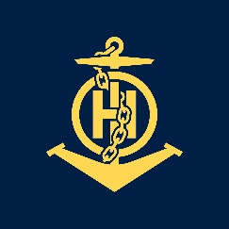
Mr
IHO – NIPPON FOUNDATION
ALUMNI SEMINAR
I GEDE YUSSUPIARTHA SAS TANGEB

Slide 2
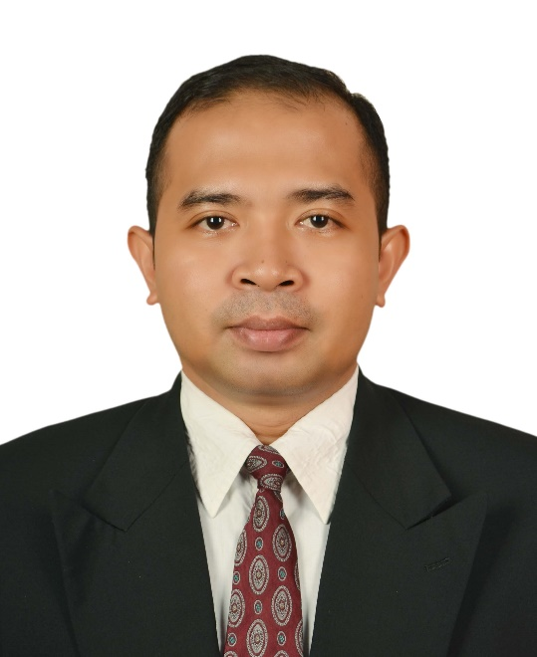
Self introduction
IHO – NIPPON FOUNDATION
ALUMNI SEMINAR
Name | I GEDE YUSSUPIARTHA SAS TANGEB
Alumni year | 2015
Country | INDONESIA
Organization | HYDROGRAPHY AND OCEANOGRAPHY CENTER – INDONESIA NAVY
Position/Job title | NAUTICA DIVISION STAFF OFFICER
Current job description | CHART MAINTENANCE (NTM PRODUCTION AND NAUTICAL PUBLICATION)
Please put your photo here!

Slide 3
My career path and projects / Achievements
IHO – NIPPON FOUNDATION
ALUMNI SEMINAR
Previously I on duty in Charting Division exactly working at paper chart compilation and correction, otherwise I handled Spatial Fusion Enterprice (SFE), that’s namely a system for displaying spatial data.
Currently I work in Nautica Division. The division is not much different from Charting Division. Charting has responsibility to chart production and, Nautica Division has responsibility to chart maintenance (NTM production and some for nautical publication)

Slide 4
Lessons learned from CHART Course
IHO – NIPPON FOUNDATION
ALUMNI SEMINAR
The course is very useful, they learn details how to produce a good and accurate chart for safety navigation, especially chart compilation (sounding selection, create counter, coastline, etc), how to select data should be drawn or not.
Knowing about software for charting, specifically CARIS
Knowing about the chart correction

Slide 5
Suggestion for the future
IHO – NIPPON FOUNDATION
ALUMNI SEMINAR
Good relationship
Continues to develop our skills in chart maintenance (paper chart and ENC) and database management
exchange information about Chartography and Charting

